Slide 1
Machine Learning Clustering Algorithms
Affinity Propagation
Mean Shift
Spectral Clustering
DBSCAN
OPTICS
BIRCH

Slide 2
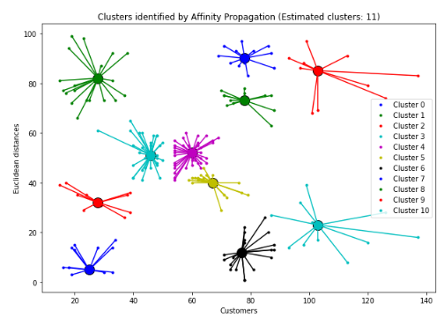
Affinity Propagation
How it works:
Does not require the number of clusters to be specified.
Uses a message-passing technique to identify exemplars (representative points).
Iteratively refines clusters based on similarities and messages exchanged between points.
Pros:
Automatically determines the number of clusters.
Works well with non-Euclidean distances.
Cons:
Computationally expensive.
Sensitive to preference parameter.
Visual:
Example of a message-passing process.
Scatter plot showing clusters formed by Affinity Propagation.

Slide 3
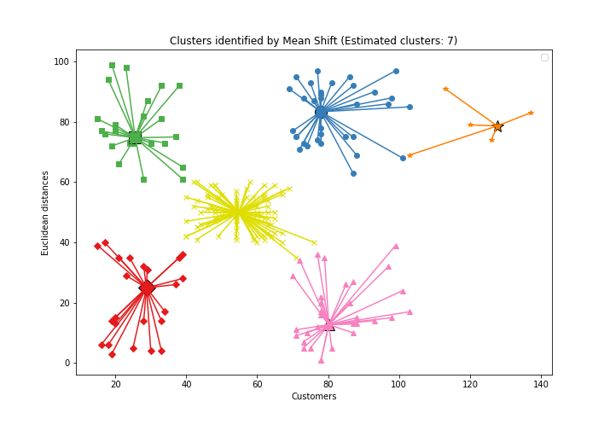
MEAN SHIFT
How it works
Does not require the number of clusters to be specified.
Uses a sliding window approach to find dense areas.
Moves points to the mean of points within the window to form clusters.
Pros:
Does not assume a specific number of clusters.
Can handle arbitrary cluster shapes.
Cons:
Computationally expensive.
Can struggle with high-dimensional data.
Visuals
Scatter plot showing clusters formed by Mean Shift.
Example of sliding window approach.

Slide 4
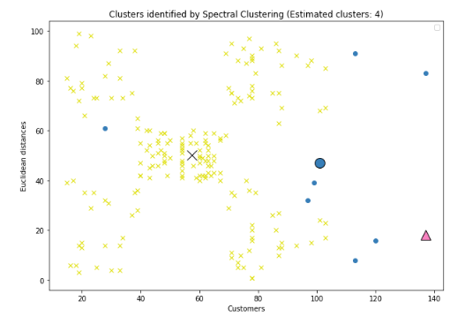
SPECTRAL CLUSTERING
How it works
Uses graph theory to partition data.
Constructs similarity graph from data.
Applies eigenvalue decomposition to identify clusters.
Pros:
Effective for complex data structures.
Can capture global relationships.
Cons:
Requires computational resources.
Sensitive to the choice of parameters.
Visuals
Example of similarity graph.
Scatter plot showing clusters formed by Spectral Clustering.

Slide 5
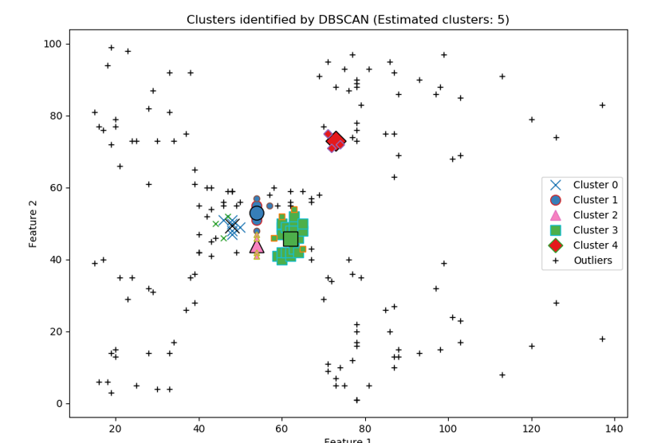
DBSCAN
How it works
Does not require the number of clusters to be specified.
Identifies dense regions by a density-based criterion.
Classifies points as core points, reachable points, or outliers.
Pros:
Does not require specifying the number of clusters.
Can identify outliers.
Cons:
Not effective for clusters with varying densities.
Parameter sensitivity.
Visuals
Example of density-based criterion.
Scatter plot showing clusters formed by DBSCAN.

Slide 6
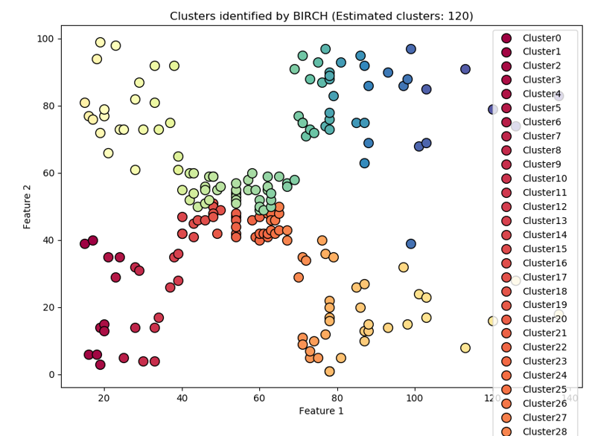
BIRCH
How it works
Builds a Clustering Feature (CF) tree from data.
Uses threshold and branching factor to control tree size.
Clusters data points incrementally.
Pros:
Efficient for large datasets.
Handles noise well.
Cons:
May struggle with small clusters.
Sensitivity to threshold parameter.
Visuals
Example of CF tree structure.
Scatter plot showing clusters formed by BIRCH.

